Slide 1

Squad Name
Squad # (shared by Deepika)
Members
Member Name (Emp No#) - 1
Member Name (Emp No#) - 2
Member Name (Emp No#) - 3
Member Name (Emp No#) - 4
Member Name (Emp No#) - 5

Slide 2

What was done as part of case Study​
Declarative Vs Scripted Pipeline
Created VM’s (Deploy/Test/Prod) using Ansible​
Built Pipeline using Groovy ​
Integrated GIT, Slack and Jira​
Monitoring the Deploy VM for CPU Performance (ELK)​
Containerize the app – Build => Push => Run​
Deploy in Kubernetes

Slide 3
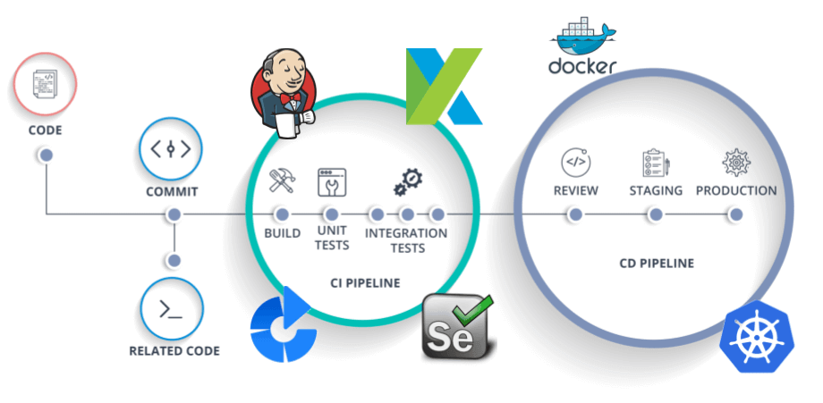
CI /CD Pipeline
Sample replace with your pipeline view

Slide 4








Links
Jira https://devopssquad13.atlassian.net/
GitHub https://github.com/rahulrayala/DevOps-Demo-WebApp/blob/master/Jenkinsfile (Jenkins file link)
Jenkins http://35.184.194.133:8080/ (User: Jenkins | Pass: Jenkins)
SonarQube http://35.225.246.10:9000/projects(User: admin | Pass: sonar)
Slack https://app.slack.com/client/T01LPCD2AKX/C01MK6L4E07
Jfrog https://rahulrayala1.jfrog.io/ui/login/
Blazemeter https://a.blazemeter.com/app/#/accounts/747871/workspaces/755994/dashboard
Test Server http://34.72.154.124:8080/QAWebapp/ (User: tomcat| Pass: tomcat)
Prod Server http://35.188.221.215:8080/ProdWebapp/(User: tomcat| Pass: tomcat)

Slide 5
